Slide 1
Monday 21 March 2022 9.30am – 11.30am
Filmed live at DY1 Community Centre

Slide 2
Welcome and Introductions
Councillor Ruth Buttery
Cabinet Member for Children’s Services

Slide 3
Welcome and Introductions
Five key priority areas for the Early Help Strategy:
Develop our culture and practice
Build our capacity – help even earlier
Make better use of information
The family experience
Focus on priority areas

Slide 4
Welcome and Introductions
Stronger emphasis on building family resilience
Enabling ‘self-serve’ approach

Slide 5
Our hosts
Nital - Chair of Youth Council
Amman - Youth Crime Commissioner

Slide 6
Today
9:45 Chief Superintendent, Dudley Neighbourhood Policing Unit: Kim Madill
9:55 Director for Children’s Services, Dudley Council: Catherine Driscoll
10:05 Chief Nursing Officer, Black Country and West Birmingham CCG and Black Country and West Birmingham ICS Lead Nurse: Sally Roberts - Pre-recorded
10:10 Service Director -Early Help, Schools & SEND, Dudley Council: Helen Ellis and Scott Jones
10:20 Break
10:25 Develop our Culture and Practice Kaye Pedley and Paul Townsend

Slide 7
Today
10:35 Build our capacity; Help even earlier - Pre-recorded
10:45 Make Better Use of Information - Pre-recorded
10:55 The Family Experience - Pre-recorded
11:05 Break
11:10 Focus on Priority Areas - Sally Cornfield
11:20 The Importance of Early Help in Safeguarding - Vicky Buchanan (Independent Scrutineer, DSPBB) Pre-recorded
11:25 Close – Councillor Ruth Buttery

Slide 8
Chief Superintendent Kim Madill
Dudley Borough Commander
Early Help
West Midlands Police

Slide 9
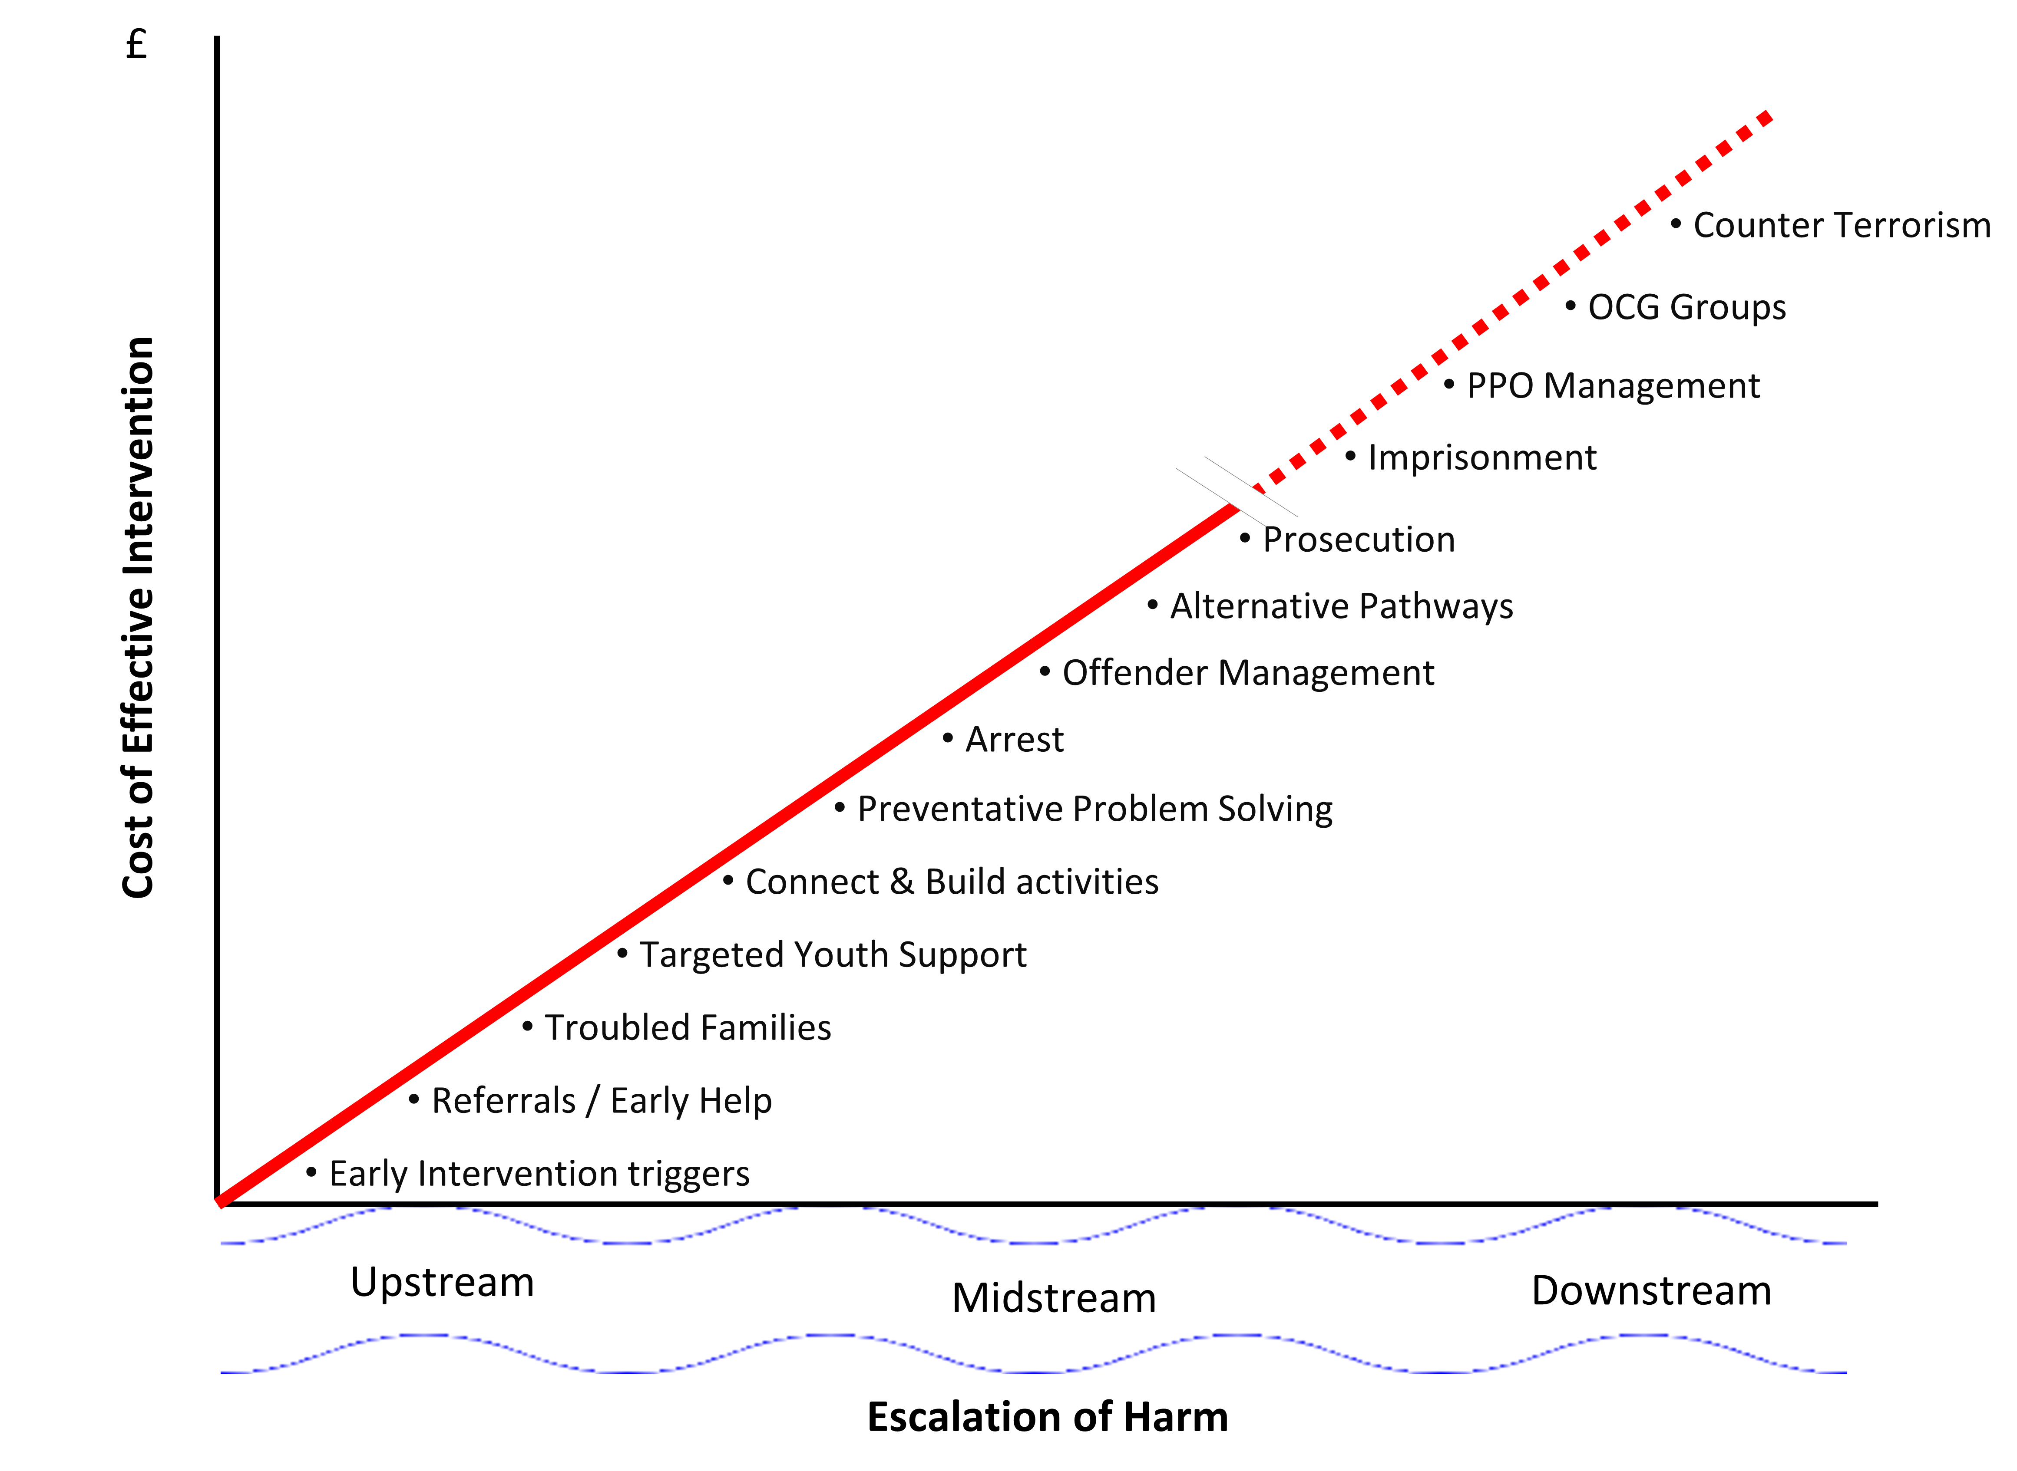
What is the Role of Neighbourhood Policing in Dudley?
“Get upstream”
Prevent harm by getting tough on its causes
Notes:
The role of Neighbourhood policing is to prevent harm in the first place (early help model) and prevent harm happening again (preventative problem solving) alongside activities designed to activate citizens and build community resilience.
We know the later the intervention the greater the cost to organisations, but also the greater the harm to individuals and communities, this is shown in studies that have been completed – not just for policing, but for many services. This is why the need to work in partnership for the benefit of our communities is vitally important – more about how we are going to build on that shortly.

Slide 10
What is the service offer of Neighbourhood Policing ?
Prevent harm at the earliest possible opportunity
Reduce demand through early intervention and preventative problem solving
Prevent reoffending through consistent, effective Offender Management
Activate citizens and mobilise communities to build community resilience
Increase delivery with partners to reduce harm through early intervention
Increase public confidence via focussed and smart approaches to understanding public need which informs our response and builds on trust & legitimacy
Notes:
The work of Dudley Neighbourhood Policing unit is in line with the above approaches and can be simply framed around the below headings:
Prevention – working to build resilience in communities, focussing on a strengths based, trauma informed approach (Just in time prevention v long term upstream prevention). ACEs training 2016 & refreshed Trauma informed Training via Barnardos in Dudley is currently ongoing
Diversion - working with partners to divert people away from harm through our local pathways including our multi-agency exploitation hub, work through the volunteer sector and for policing we specifically try to engage young people into our Princess Trust and Cadets schemes that are supported by PCSOs as well as volunteer cadet leaders
Enforcement – by taking action against offenders and disrupting criminals and gangs
Rehabilitation – through working with perpetrators and offenders in our offender management model alongside probation colleagues
We have a mixture of Police officers, PCSOs and Police staff members delivering this service across
Neighbourhood teams – which are placed based and aligned to a number of wards,
Neighbourhood Task Force – which are a proactive team mainly focussed on trying to disrupt serious organised crime
Partnership Team – incorporating our licencing officers, vulnerability officer, ASB and Crime portfolio and Young persons officers
Local Offender management Team – the rehabilitative function mention above – seeking to prevent reoffending, incorporating staturory responsibilities under MAPPA (Multi-agency Public Protection arrangements) for violent and sex offenders
The early help work sits mainly in Neighbourhood teams and our Partnership function

Slide 11
Increase of Police Officers to Dudley Neighbourhood Policing Unit
5 additional officers dedicated to Early Help roles will join Dudley in July 2022
As part of our Neighbourhood Partnership Team they will be aligned to each of the 5 borough Early Help clusters (Brierley Hill, Halesowen, Stourbridge, Dudley North and Dudley Central)
Trained prior to arrival, but will need local onboarding with partners in the clusters thereafter to share details of our local Early Help Model & Strategy
Notes:
The role of the EH officers will be - to provide a coordinated approach to early help, intervention and prevention across the Neighbourhood Policing Unit.
- to identify issues of vulnerability across communities involving children and families and maximise opportunities to reduce demand and to support with early help and appropriate interventions
- to support those families and be the link between WM Police and the partnership Early Help Structure, to strengthen existing partnerships, to reduce violence, risk and vulnerability and provide every opportunity for children and families to prosper.
We will be working with colleagues over the coming months to design the logistics in order to welcome the new officers to the team at Dudley.
In addition to the newly trained officers – we are currently undergoing CPD for every officer focussing on vulnerability – what it is and what we need to do as a service when we identify it.
The training also differentiates between vulnerability and safeguarding thresholds to ensure that we are getting the right referrals to the right places within the model.

Slide 12
Early Help – Dudley Council
Catherine Driscoll Director of Children’s Services

Slide 13
Early Help – Health
Sally Roberts Chief Nursing Officer, Black Country and West Birmingham CCG and Black Country and West Birmingham ICS Lead Nurse

Slide 14
Sally Roberts https://www.youtube.com/watch?v=C-BQqQTmtaE

Slide 15
Next Steps
Helen Ellis Service Director - Early Help, Schools & SEND
Scott Jones Head of Service, Family Solutions

Slide 16
Our vision for Early Help in Dudley
The right approach
Friendly, reassuring, down to earth conversations, self-serve ethos
In the right place
We are all alert and willing to offer Early Help where our children and families go day to day
At the right time
Help at an early stage of a problem or early in a child’s life.

Slide 17
Five pillars
Develop our culture and practice
Build our capacity – help even earlier
Make better use of information
The family experience
Focus on priority areas

Slide 18
Develop our culture and practice
The steering group will hold all partners to account for their contributions to Early Help, ensuring all agencies make proportionate
We will ensure there is good and consistent understanding of thresholds by all practitioners, to ensure families across the borough get the help they need
We will ensure all agencies who work with children young people and their families include Early Help in induction of new staff, and will require all partners to report progress to the steering group
We will clarify our governance arrangements to maximise our strategic capacity and oversight to drive this work forward
We will ensure there is clarity about who can and should act as a lead professional, and what this means

Slide 19
Build our capacity – help even earlier
We will support the roll out of Cluster Connect across the borough
We will develop a Volunteers Strategy and Action Plan to increase our Early Help workforce
We will seek the support of our community workforce to help families whose needs are at level 2 on the continuum to prevent issues escalating
We will seek to pool financial resources across the partnership to increase our enabler workforce

Slide 20
Make better use of information
We will develop a borough wide performance management and outcomes-based quality assurance framework
Commissioners and Service Leaders across the partnership will use performance reports to hold services to account for the delivery of Early Help and will report to the Steering Group how they are making a difference
We will seek to find better IT solutions to our partnership working and will work to identify systems which talk to each other to ensure work is seamless
We will create an online portal for partners to submit Early Help Assessments, check on progress of an assessment or delegate work to colleagues

Slide 21
The family experience
We will make sure that information about the support services which are available to children, young people and families is available in an accessible and easy to navigate form, so that more families can self-serve
We will make our pledge to families meaningful in our day-to-day practice, and in particular through use in reviews and evaluations
We will develop an engagement strategy to ensure all families understand what early help is and how to access it – reassuring families about the approach
We will use feedback from families to inform everything we do
We will work on ways to build on family strengths and resilience in our work, rather than focusing on deficits

Slide 22
Focus on priority areas
Focussing on Early Years
In phases over 3 years, starting with our approach to the child’s first 1001 days by working nationally with the Early Intervention Foundation & Early Years Transformation Academy
Focussing on school readiness
to ensure our children get the best start in life. Making sure all children can benefit from education and will focus on inclusion, supporting all children to reach their full potential, accessing mainstream education where possible

Slide 23
Our pledge to children, young people and their families
We will make every contact count
We will listen to you and not judge you
We will “work with” you and not “do to you”
We will give you one point of contact
Our assessments and plans will be uncomplicated and robust
We will take care of your information
We won’t pass the buck

Slide 24
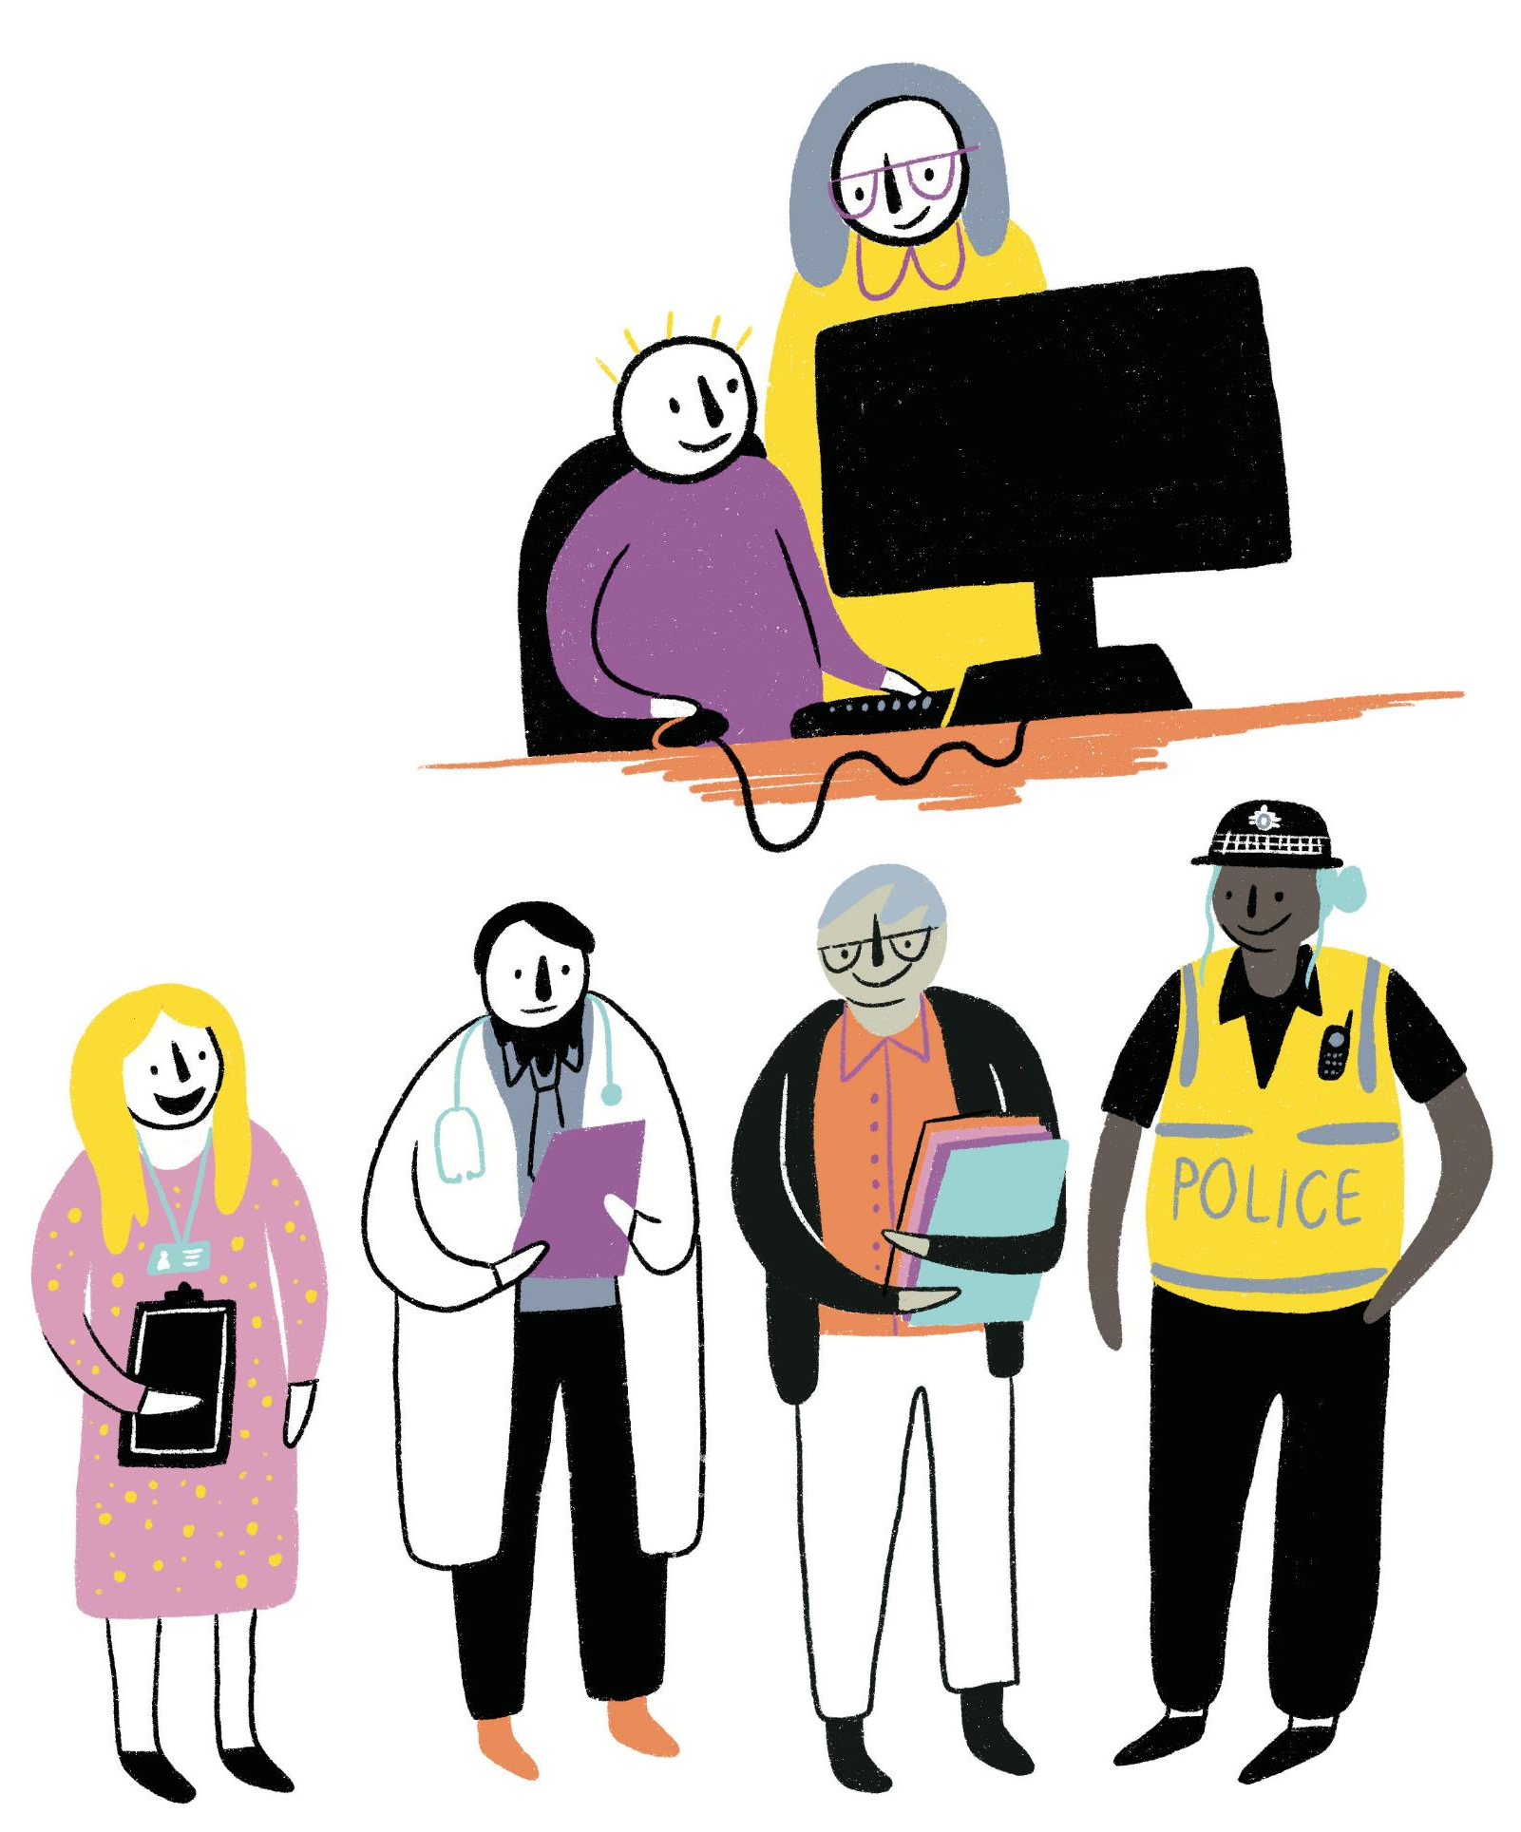
Break (5 minutes)
Coming up…
Develop our Culture and Practice
Build our capacity; Help even earlier
Make Better Use of Information

Slide 25
Develop our Culture and Practice
Kaye Pedley – Senior Early Help Enabler
Paul Townsend – Senior Inclusion and Safeguarding Lead Dudley Academies Trust

Slide 26
What are the outcomes for Education?
The steering group will hold all partners to account for their contributions to Early Help, ensuring all agencies make proportionate contributions and fulfil their responsibilities.
Education are represented and play an active part within the Early Help Steering Group.
Early Help Assessment process reviewed through workshops attended by Education.
Strategic planning included the voice of Education and other partner agencies.

Slide 27
What are the outcomes for Education?
We will ensure there is good and consistent understanding of thresholds by all practitioners, to ensure families across the borough get the help they need.
Early Help Assessment Audits conducted monthly.
Education support through quality assurance checks for Early Help Assessments.
Best practice identified and shared during Education forums.
Early Help Enablers provide support and guidance to individual providers.

Slide 28
We will ensure all agencies who work with children young people and their families include Early Help in induction of new staff, and will require all partners to report progress to the steering group.
What are the outcomes for Education?
Safeguarding training includes Early Help information, processes and procedures.
The need for identifying needs at the earliest possible stage is clear in Safeguarding policies within each school/academy.
Safeguarding in Education training provided to all staff both teaching and non-teaching.

Slide 29
We will clarify our governance arrangements to maximise our strategic capacity and oversight to drive this work forward.
What are the outcomes for Education?
Dudley Teenage Pregnancy Support Services provided support to Education in Dudley through a direct referral route.
The service was closed in 2019 and no replacement service identified.
Early Help facilitated a multi-agency strategic working group to formulate the new Teenage Pregnancy Pathway.
New focus on Early Years and supporting children to reach their full potential through positive outcomes.

Slide 30
We will ensure there is clarity about who can and should act as a lead professional, and what this means.
What are the outcomes for Education?
Education staff felt that they were often expected to be Lead Professional if they completed the assessment.
This was reflected in a reduction of the number of Early Help Assessments being completed.
Strategic changes implemented to ensure that the family were at the centre of identifying the Lead Professional.
Electronic referrals and management system accessible to Education staff.

Slide 31
What are the outcomes for Education?
Everyone in Education understands their responsibilities in keeping children safe. Identifying the need is just the start.
The new Threshold document 2021 clearly identifies referral pathways.
Level 2 offers single need support for SEN, socialisation, NEAT, language and Communication and not reaching full educational potential.
Level 3 offers support with complex or multiple needs, including Exclusions, Truancy, Preventing Permanent Exclusions, Missing in Education and EHCP’s.

Slide 32
What are the outcomes for Education?
Early Help offers wider contextual safeguarding support. For Education it gives you access to agencies that will make a positive difference to the individual, the family, the school and the wider community.
Private Fostering, Radicalisation, Honour based abuse, Parent in Prison, Mental Health, Modern day slavery, Homelessness, Health concerns, substance use, domestic abuse, missing, young carers, youth violence and exploitation.
Early Help staff will coordinate the support and formulate a plan, holding external agencies to account.

Slide 33
Build our capacity; help even earlier
How Safe Families support Families
Safe Families recruit, train and support volunteers in the community to build relationships that bring hope to those in need.

Slide 34
Tam’s Story https://vimeo.com/545966647

Slide 35
Making better use of information
Improve quality
Hold each-other to account
Better IT solutions
Improve outcomes for families

Slide 36
Make better use of information https://youtu.be/OIyOixqlBmI

Slide 37
The Family Experience
Information about support services is readily available
Help families self-serve
Using family feedback to inform everything we do

Slide 38
The Family Experience https://youtu.be/a9TzscytNy8

Slide 39
Break (5 minutes)
Coming up…
Focus on priority areas
Importance of Early Help in Safeguarding

Slide 40
Focus on priority areas
Sally Cornfield
The first 1001 days - from conception and the first two years of a child's life is a significant and influential phase in development.

Slide 41
It sets the groundwork for children's emotional wellbeing, resilience and adaptability; the competencies they need to thrive.
Ensuring a good start in life is a shared goal for all parents, families and communities, as well as for the local organisations responsible for health, education, childcare and welfare

Slide 42
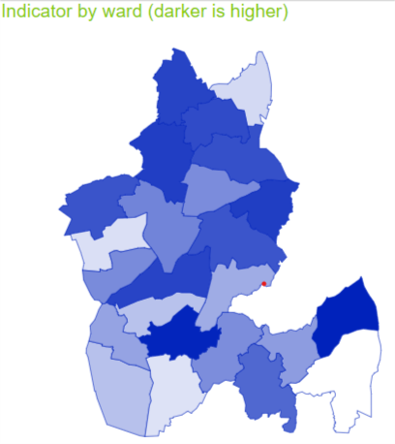
Dudley in numbers…
Infant mortality
Obesity levels at reception (NCMP)

Slide 43
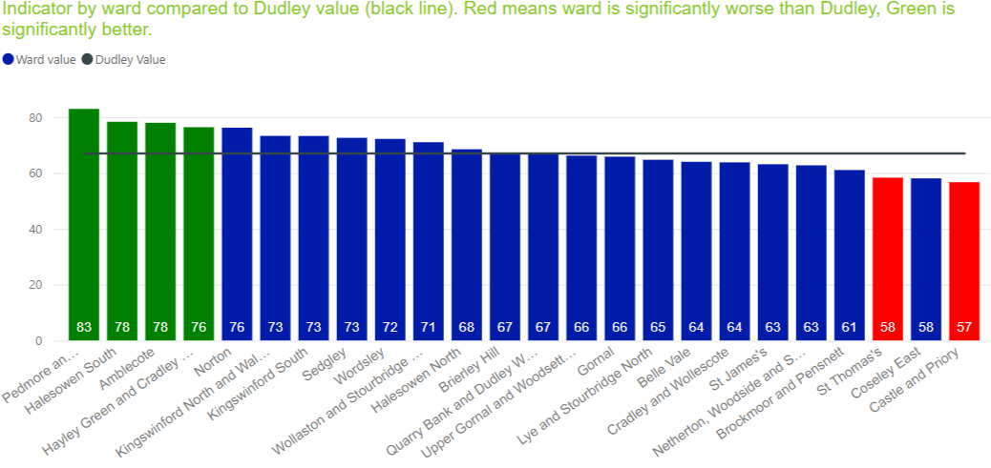
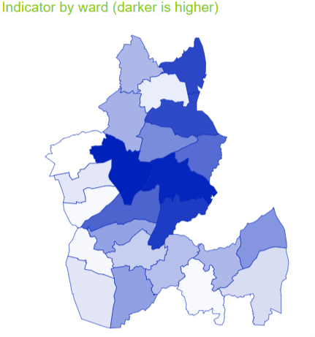
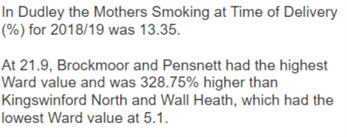
School Readiness
Smoking prevalence

Slide 44
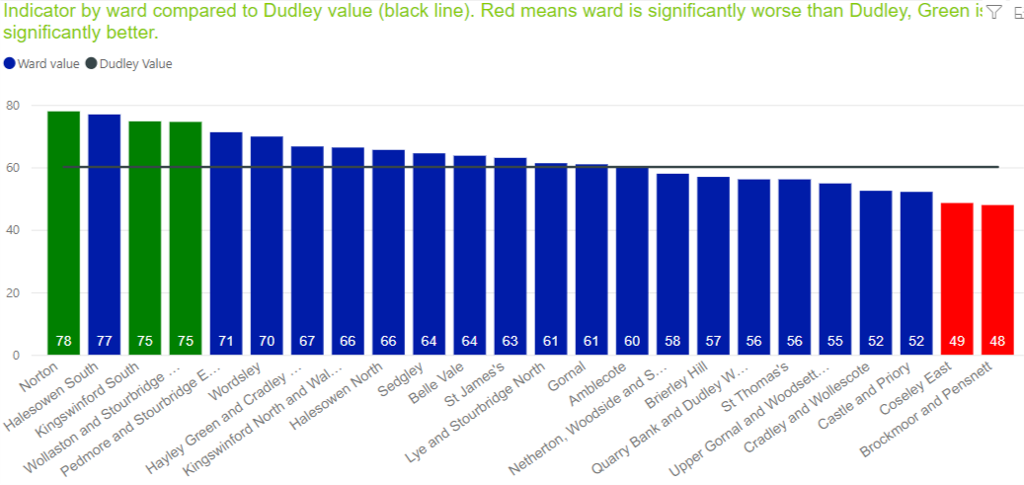
Breastfeeding 6-8 weeks

Slide 45
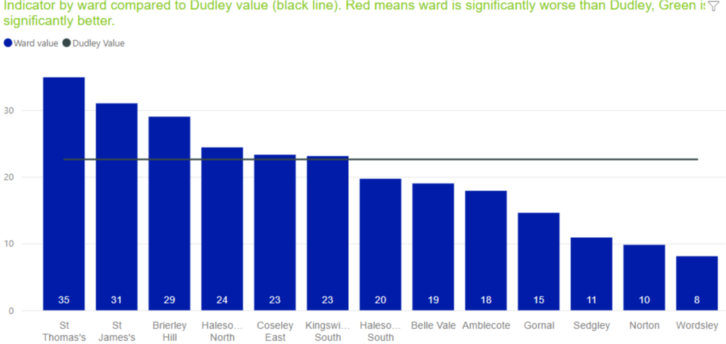
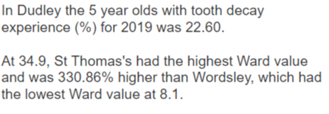
Tooth Decay

Slide 46
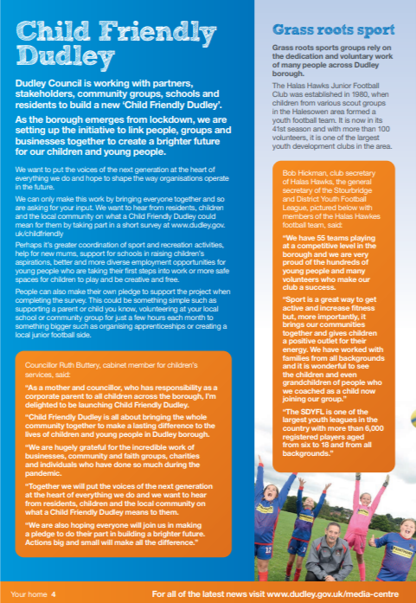
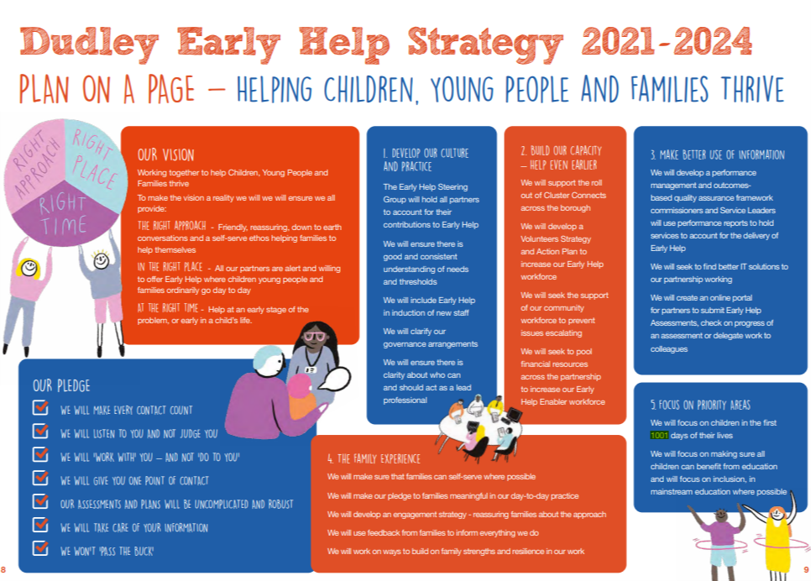
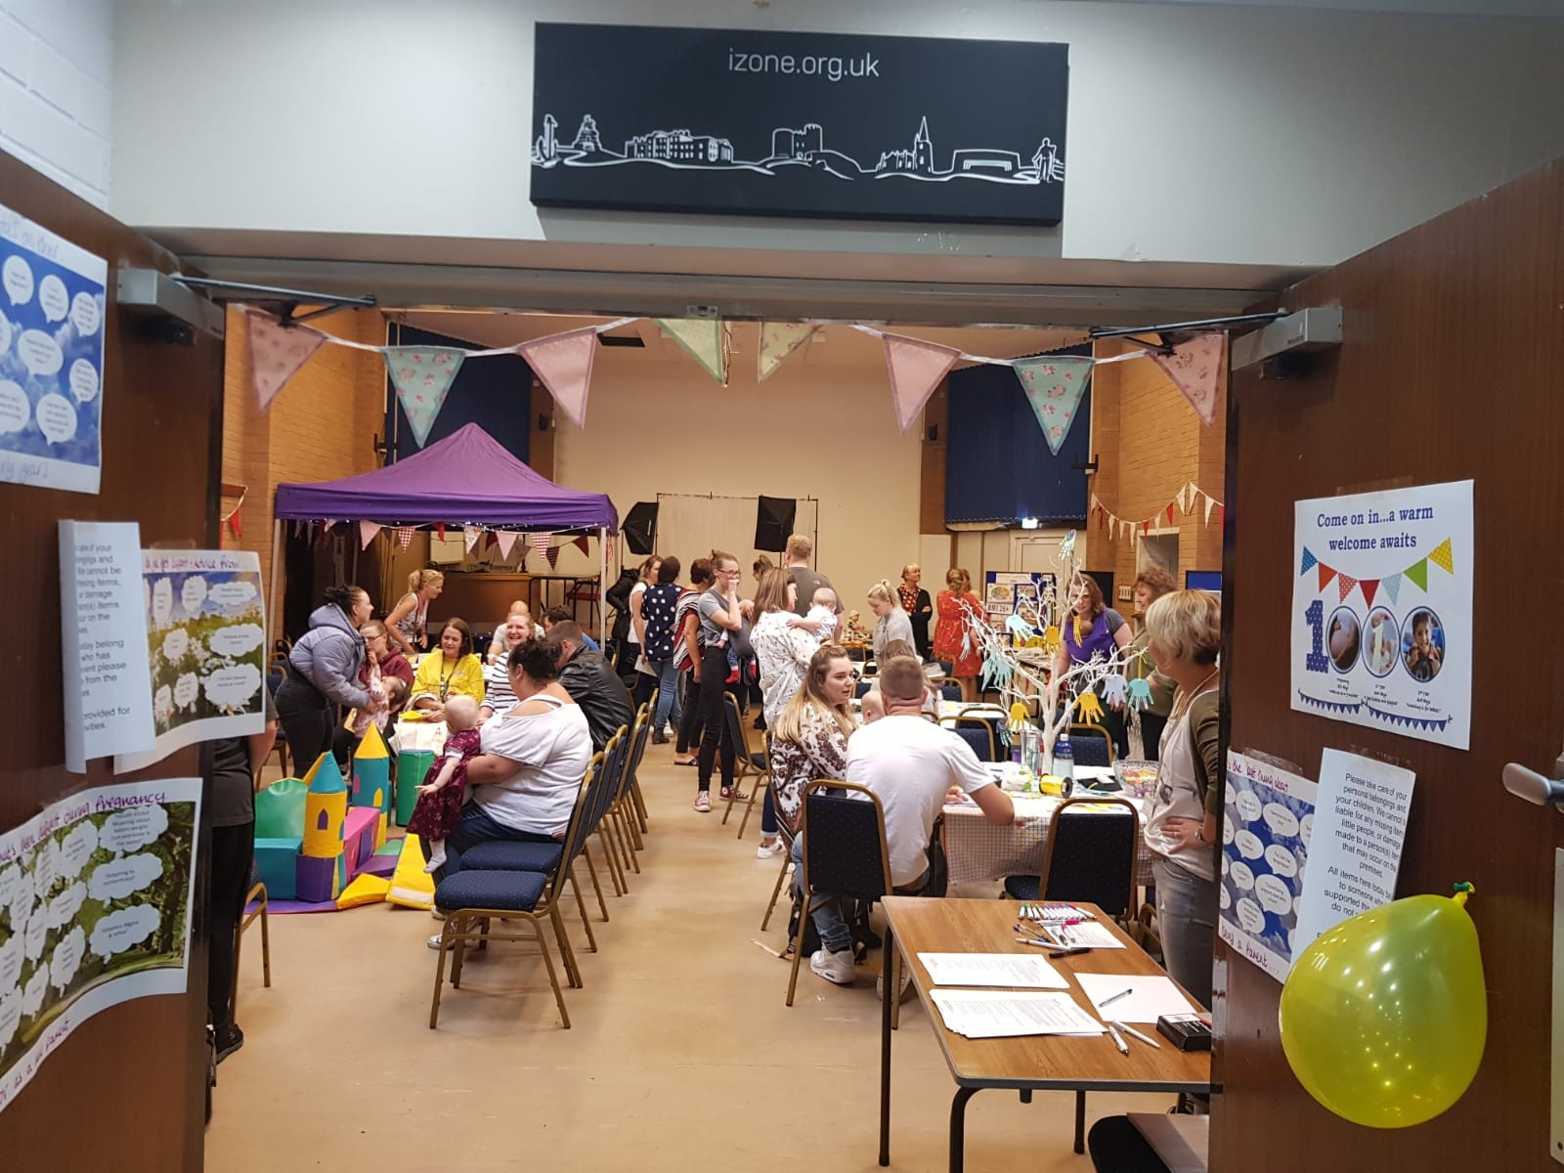
Action Area 1: Leadership for change Learning from the experiences of parents and carers; clear leadership and accountability at a local level; building the economic case for investment in the Start for Life (first 1001 days); and harnessing the support of families, volunteers and professionals to deliver the best start for life for Dudley children and families.

Slide 47
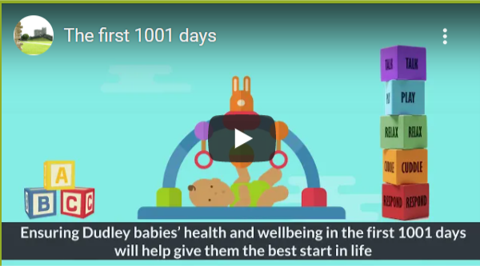
Action Area 2: Seamless support for families Working as a local system with key stakeholders and other local partners, the Local Authority and NHS should pull together a coherent and joined up first 1001 days offer and make it clearly available. The offer should explain clearly to parents and carers what services they are entitled to and how they can access them and ensure are codesigned with parents and carers.
https://youtu.be/sS3Ipl_uOoo

Slide 48
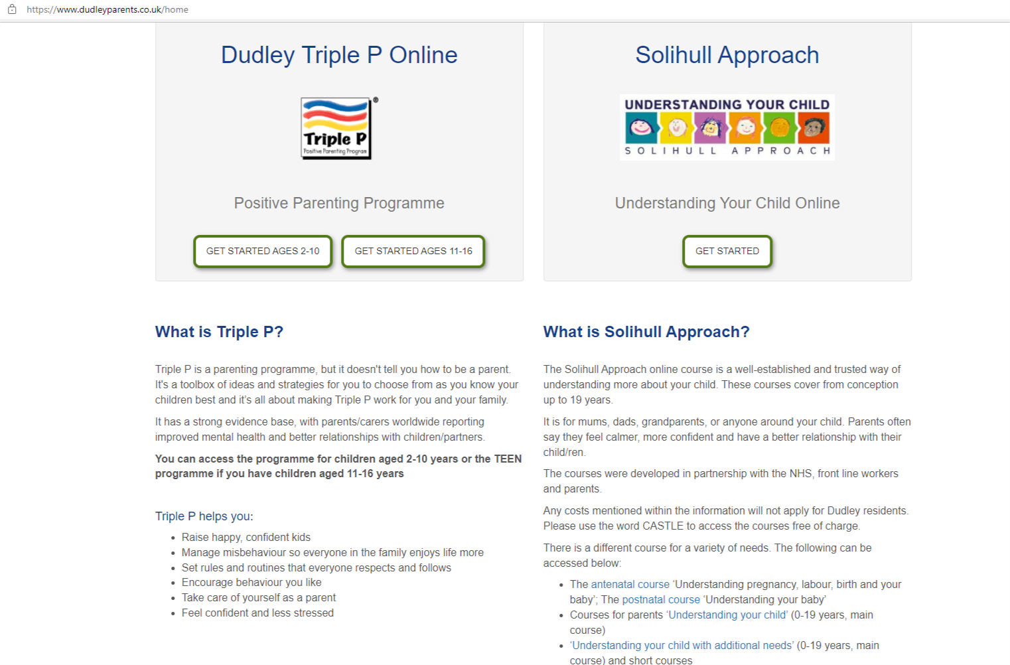
Action Area 3: A welcoming Hub for the family Championing Family Hubs as a place where parents and carers can access services (this priority can only be delivered with adequate resources being made available to local authorities).

Slide 49
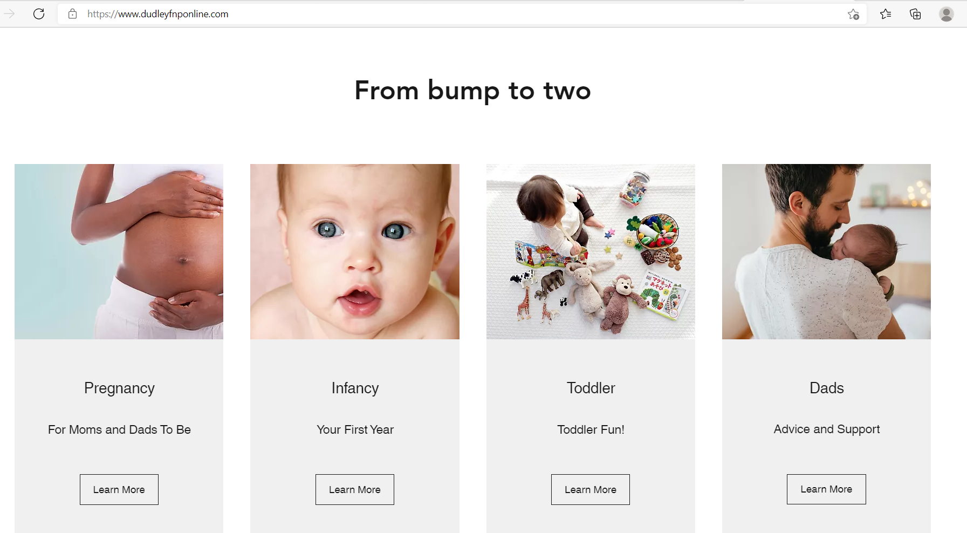
Action Area 4: The information families need when they need it How digital, virtual and telephone services will be designed around the needs of babies, parents and carers. Underpinned by the action area 2 priority - Embed Community Centred approaches in the first 1001 days plan.

Slide 50
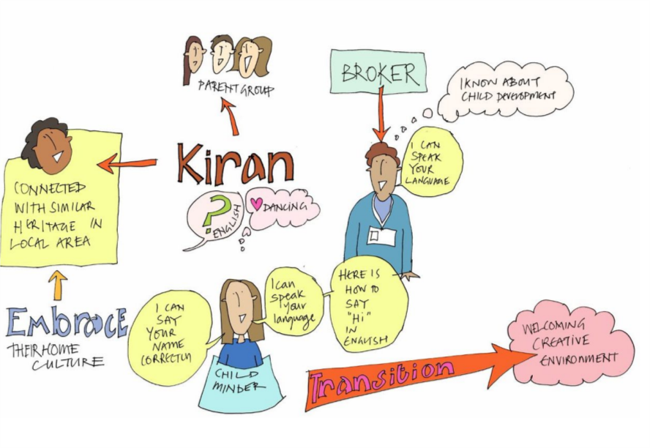
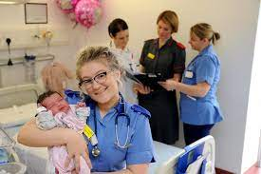
Action Area 5: An empowered workforce Building skills across the early years workforce, strengthening continuity of care and developing a modern workforce that can better meet the needs of all families.

Slide 51
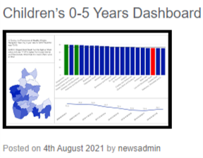
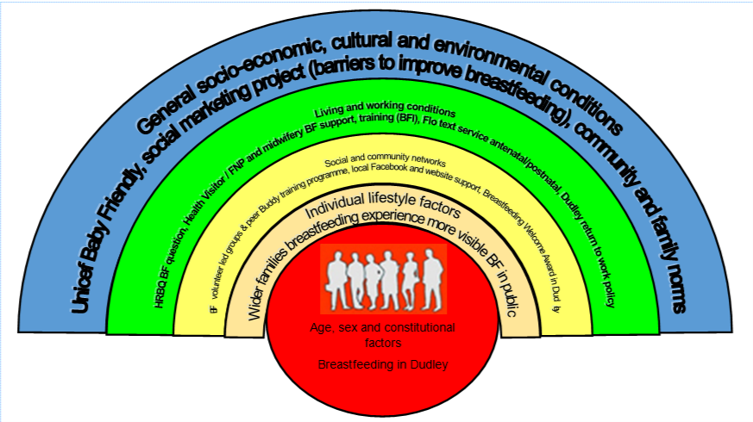
Action Area 6: Continually improving the first 1001 days offer Improving the quality and relevance of data collections; ensuring clear evaluation of ‘what works’ to implement best practice
Early Years and Maternity Needs Assessment 2020

Slide 52
Future Plans/Developments
Five to Thrive (training 22/3/22)
Child Friendly Dudley
COC Qualitative Evaluation
School Readiness Strategy
Birth Registration
0-19 Integration
Inequalities (NCMP) deep dive
Early Language Identification Measure pilot

Slide 53
The importance of Early Help in Safeguarding
Vicky Buchanan - Independent Scrutineer, DSPBB

Slide 54
Vicky Buchanan - Independent Scrutineer, DSPBB https://youtu.be/Rg87IzHCtbE

Slide 55
Thank you for attending
Councillor Ruth Buttery
Cabinet Member for Children’s Services
Dudley Health and Wellbeing Board - https://www.dudleyhealthandwellbeing.org.uk/ earlyhelpstrategy
Event feedback - https://www.surveymonkey.co.uk/r/DudleyEarlyHelpStrategy
Safe Families - Tam’s Story https://vimeo.com/545966647 Mandy’s Story- https://youtu.be/OXvIbPNfwSQ
The Family Experience - https://youtu.be/a9TzscytNy8
Make better use of information - https://youtu.be/OIyOixqlBmI

