Slide 1
CHILDREN’S AUTISM ASSESSMENT SERVICE ( (AUTISM ASSESSMENT SERVICE FOR CHILDREN UNDER 5 YEARS OLD IN THE DUDLEY BOROUGH)

Slide 2
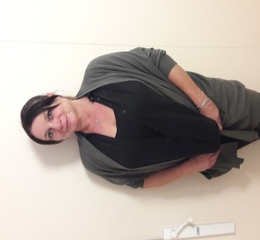
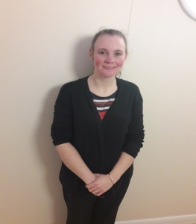
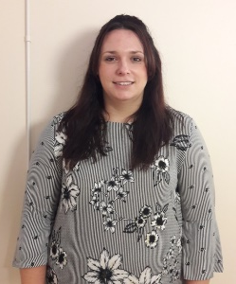
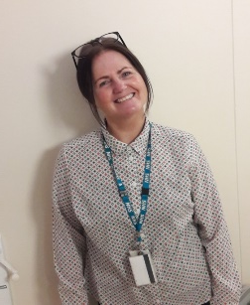
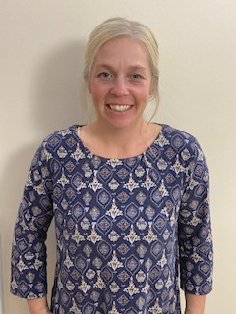
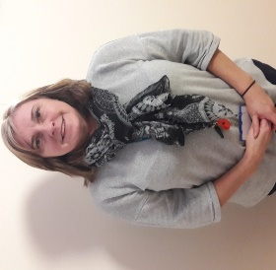
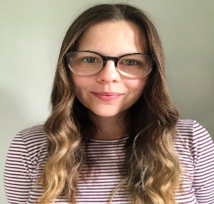
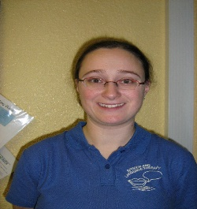
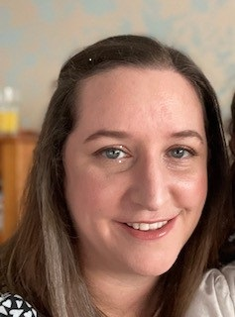
MEET THE CAAS TEAM
MARIA CATMUR BECKY GETHEN JENNY DENNIS BECKY CARTER ELLEN HENRY
SPECIALIST NURSERY NURSE SPECIALIST NURSERY NURSE TEAM LEADER TEAM ADMINISRATOR SPECIALIST HEALTH VISITOR
NURSE
VICKY WESTWOOD MELANIE LOWE KATE POWELL LUCY JENKS
SPECIALIST NURSERY NURSE SPECIALIST SPEECH AND SPECIALIST SPEECH AND SPECIALIST OCCUPATIONAL
LANGUAGE THERAPIST LANGUAGE THERAPIST THERAPIST
Our assessment nursery is at the Sunflower Centre and our office is based at The Ridge Hill Centre

Slide 3
REFERRALS
Children under the age of 5
Dudley GP
We accept referrals from:
Paediatrician
SPOA – via Health Visitor, GP, Speech therapist, IEYS
The children must have been seen by Speech, IEYS and be in a nursery to be accepted to CAAS for an autism assessment

Slide 4
CAAS AUTISM ASSESSMENT PATHWAY We complete multidisciplinary autism assessments following the National NICE guidance (CG128) (AUTISM SPECTRUM DISORDER IN UNDER 19S:RECOGNITION, REFERRAL AND DIAGNOSIS 2017)
Initial appointment given within 12 weeks of receipt of referral
Initial appointment over telephone or face to face
Observations in nursery/school
Home visit
ADOS (if required)
Sunflower Nursery sessions
MDT meeting with all professionals
Parent feedback appointment
6 week post diagnosis follow up telephone call
We aim to support out families throughout the autism assessment and so will refer to other services
OUR ASSESSMENTS CURRENTLY TAKE 12-18 MONTHS FROM FIRST APPOINTMENT TO DIAGNOSIS MEETING

Slide 5
MDT meetings
We invite all professionals involved with the child to attend their MDT meeting.
They take place over TEAMS
We send questionnaires out to settings so if they cannot attend then these can be returned and we then have evidence from them to share at the MDT meeting
We go through the ICD11 autism diagnostic criteria from the
World Health Organisation
We always then feedback to parents within 48 hours

Slide 6
ICD 11 AUTISM SPECTRUM DISORDER DIAGNOSTIC CRITERIA
Essential (Required) Features
SECTION A:
Understanding of, interest in, or inappropriate responses to the verbal or non-verbal social communications of others.
Integration of spoken language with typical complimentary non-verbal cues, such as eye contact, gestures, facial expressions and body language. These non-verbal behaviours may also be reduced in frequency or intensity.
Understanding and use of language in social contexts and ability to initiate and sustain reciprocal social conversations.
Social awareness, leading to behaviour that is not appropriately modulated according to the social context.
Ability to imagine and respond to the feelings, emotional states, and attitudes of others.
Mutual sharing of interests.
Ability to make and sustain typical peer relationships

Slide 7
ICD 11 AUTISM SPECTRUM DISORDER DIAGNOSTIC CRITERIA CONTINUED…
SECTION B:
Lack of adaptability to new experiences and circumstances, with associated distress, that can be evoked by trivial changes to a familiar environment or in response to unanticipated events.
Inflexible adherence to particular routines; for example, these may be geographic such as following familiar routes, or may require precise timing such as mealtimes or transport.
Excessive adherence to rules (e.g., when playing games).
Excessive and persistent ritualized patterns of behaviour (e.g., preoccupation with lining up or sorting objects in a particular way) that serve no apparent external purpose.
Repetitive and stereotyped motor movements, such as whole body movements (e.g., rocking), atypical gait (e.g., walking on tiptoes), unusual hand or finger movements and posturing. These behaviours are particularly common during early childhood.
Persistent preoccupation with one or more special interests, parts of objects, or specific types of stimuli (including media) or an unusually strong attachment to particular objects (excluding typical comforters).
Lifelong excessive and persistent hypersensitivity or hyposensitivity to sensory stimuli or unusual interest in a sensory stimulus, which may include actual or anticipated sounds, light, textures (especially clothing and food), odours and tastes, heat, cold, or pain.

Slide 8
ICD 11 CONTINUED…
Additional Clinical Features (non-essential):
Common symptom presentations of Autism Spectrum Disorder in young children are parental or caregiver concerns about intellectual or other developmental delays (e.g., problems in language and motor coordination).
Pragmatic language difficulties may manifest as an overly literal understanding of others’ speech, speech that lacks normal prosody and emotional tone and therefore appears monotonous, lack of awareness of the appropriateness of their choice of language in particular social contexts, or pedantic precision in the use of language.
Social naiveté, especially during adolescence, can lead to exploitation by others, a risk that may be enhanced by the use of social media without adequate supervision.
Profiles of specific cognitive skills in Autism Spectrum Disorder as measured by standardized assessments may show striking and unusual patterns of strengths and weaknesses that are highly variable from individual to individual. These deficits can affect learning and adaptive functioning to a greater extent than would be predicted from the overall scores on measures of verbal and non-verbal intelligence.
Self-injurious behaviours (e.g., hitting one’s face, head banging) occur more often in individuals with co-occurring Disorder of Intellectual Development.
Some individuals with Autism Spectrum Disorder are capable of functioning adequately by making an exceptional effort to compensate for their symptoms during childhood, adolescence or adulthood. Such sustained effort, which may be more typical of affected females, can have a deleterious impact on mental health and well-being.

Slide 9
OCCUPATIONAL THERAPY SUPPORT
SENSORY WORKSHOPS
SELECTIVE EATING WORKSHOPS
TELEPHONE REVIEW APPOINTMENTS
FACE TO FACE ASSESSMENTS

Slide 10
OTHER THINGS TO CONSIDER
ATTACHMENT DISORDER
EARLY CHILDHOOD EXPERIENCES
SAFEGUARDING CONCERNS
PARENTAL MENTAL HEALTH
DOMESTIC ABUSE
GLOBAL DEVELOPMENTAL DELAY
ADHD
GENETIC CONDITIONS
We meet with CAMHS under 5s team once a month to liaise with them regarding any children with some of the above
We liaise with the wider multidisciplinary team if we have any of the above concerns
We use the Coventry grid to support attachment concerns
If we cannot be 100% certain that a child’s needs are just linked to Autism then we will NOT give a diagnosis
All children have a plan put into place during and at the end of their assessment regardless of whether or
not they are given a diagnosis of autism.

Slide 11
ANY QUESTIONS??

