Slide 1
Notes:
Timing 30 s

Slide 2
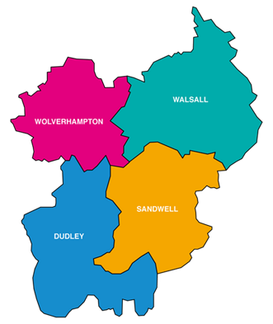
Black Country Rape
&
Sexual Violence Service
Independent Sexual Violence Adviser Service (ISVA)
Adult Survivors of Childhood Sexual Abuse (CSA ISVA)
Specialist Children’s Violence and Abuse Support (CHISVA)
Community Development ISVA
Counselling and Therapeutic Services
Notes:
Time 40s
Running time: 1.10
Team of 12 ISVAs and CHISVAS

Slide 3
Independant Sexual
Violence Advisor
(ISVA)
Notes:
Timing: 25s
Running time: 1.35
An ISVA can support Adults from 18yrs +
They offer support to people who have experienced any form of sexual violence, both recent and historic.
Our CSA ISVA offers support to people who experience Childhood sexual abuse.

Slide 4
What is an ISVA
Criminal Justice Support
Providing service users with knowledge about their rights within the CJS process
Emotional Support
Offering a flexible approach to service users and adapting to their needs
Additional support
Providing an holistic multi-agency approach
Notes:
Timing 3 min
Running time: 4min .35
CJS:
Independent from the police
ISVA can act as the link between the police and the client
Explain reporting process from report to court
ISVA can attend police and court appointments
Support applying for Criminal Injuries compensation Award (CICA) if eligible
Partnership working with police and Crown Prosecution Service (CPS) to ensure a positive client outcome
Advocate for views and feelings
Emotional
They do not have to report it to the police to access support
One to one support sessions – over the phone, video call or face to face
Person centred approach- support the client to move forward e.g. nightmares, coping strategies and self- esteem
Confidential ear
Additional
Supporting with access to health and other related services
Holistic, multi agency approach to support
Risk assessment and support plan is regularly reviewed to ensure client’s safety and they are receiving quality support

Slide 5
CHILDREN'S INDEPENDENT SEXUAL VIOLENCE ADVISOR
(CHISVA)
Notes:
Timing 20s
Running time 4min .55
Offer support between the ages of 5 - 18
Whether it was a recent or historic case of sexual abuse

Slide 6
What is a CHISVA?
Similar to an ISVA:
CJS support
Emotional support
Additional support
Additional responsibilities:
CHISVA’s main concerns are the safeguarding and well being of a child/ young person
Act as a school liaison
Notes:
Timing: 1.45
Running time: 6min 40
CJS:
ISVA can act as the link between the police and the client
Explain reporting process from report to court
Advocate for views and feelings
Emotional Support:
Flexible support that consists of 6 focus sessions of one to one support, if more are needed CHISVA will review and asses using Support plan
Creative and engaging interventions e.g. drawing, distraction boxes, bubble breathing
Confidential ear to speak freely about how they are feeling
Parental support groups
Safeguarding:
All members of the rape and sexual violence service are responsible for Safeguarding, however as a CHISVA has more direct contact with the child/young person they are able to provide a more detailed insight to the child than their adult counter parts.
Liaising with school and providing education and awareness of trauma, and the impact of trauma to staff.

Slide 7
How is support offered?
Notes:
Timing: 3.20
Running time; 10mins
BCWA provide a flexible way of offering support to service users:
For adults and children over 12 (unless they have additional needs) are offered:
Telephone appointments
Virtual appointments
Office based face to face appointments
and if required face to face appointments at GP surgeries
Whats app/ text support
Access to out of hours support
For children under 12 or with additional needs:
telephone appointments (if appropriate)
Office based face to face appointments
face to face appointments at their GP practice
Appointments at school
parents/guardians are provided access to out of hours support.
With each appointment and ISVA/CHISVA will take into consideration the service users surrounds making sure they are in a safe space at office locations appointment suite are designed to promote security and calmness
An ISVA/CHISVA will outline the nature of the support to each service user and explain what they will expect from their sessions including length of support and other factors.

Slide 8
Therapeutic Services
Specialised trauma therapy
Crisis counselling
Internal referrals
Pre/ Post trial therapy
Notes:
Timing: 2.20
Running time: 12 min.20
Specialist sexual violence trauma therapy, E.G. we have counsellors who specialise in Dissociative Identity Disorder (DID),
And we have recently recruited an EMDR specialist.
Crisis counselling – This is a direct referral from the SARC centre (both Paediatric and adult)- they can access a small block of sessions following a sexual assault that focus on stabilisation after a trauma. For children who are under 5 their parents can access crisis counselling.
Any BCWA worker can refer into counselling providing the service user is engaging in support and has experience some form of sexual violence, as a result Service users do not wait as long for counselling support.
All counsellors are trained to deliver both pre trial and post trial counselling, in line with current CPS guidelines for therapy
All counsellors follow BCAP framework for ethical practice

Slide 9
Workshops
Therapeutic Informed Parenting Sessions (TIPS)
Adventure therapy
Women’s workshops
Survivor’s coffee morning
Notes:
Therapeutic Informed Parenting Sessions (TIPS) – 6 virtual workshops focusing on helping parent(s) to understand and normalise trauma behaviour, opportunity for peer support
Adventure therapy – Group therapy using nature and bush crafts as a co therapist. In partnership with Wild and Well therapy.
Women’s workshops – 6 virtual sessions to help the client move forward
Survivor’s coffee morning – for closed clients who would like continued peer support

Slide 10
Community Development ISVA
Notes:
TIMING 25S
RUNNING TIME 12 MIN.25
Proactively engaging with a range of communities across the Black country
Aim to engage communities who typically find it difficult to access rape and sexual violence support

Slide 11
How do we do this?
Reaching out to local, grass root organisations embedded in hard to reach communities and agencies such as the police and local authorities.
Supporting grass root organisations and providing referral pathways information.
Notes:
Timing: 1mins
Running time:13 min.45
At BCWA we have recognised a gap in support fro harder to reach communities. To bridge this gap the CD ISVA reaches out to agencies that are embedded within these communities so we can understand what the barriers are, how we can work together to overcome these barriers and create a more equitable service for all within our community.

Slide 12
How to make a referral
Self- referral: A survivor can make a self- referral into the service by telephoning 0121 553 0090
Everyone who answers the phone uses a trauma informed response
When a referral is first made, SPOC (Single Point of Contact) completes a comprehensive triage assessment to identify if the survivor will benefit from support.
Notes:
Timing: 1.40
Timing 15 min.25

Slide 13
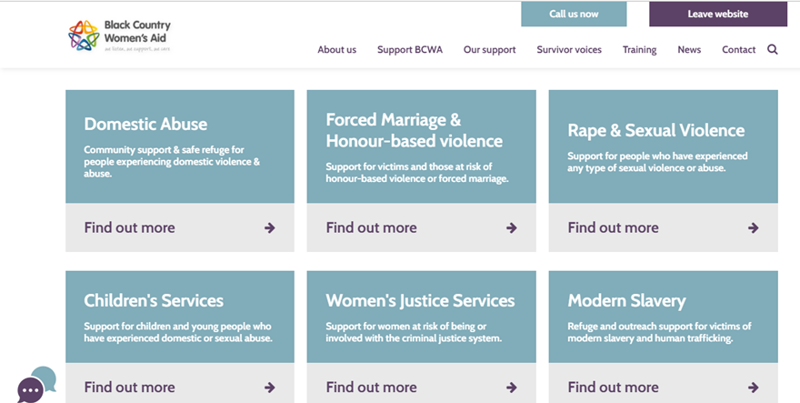
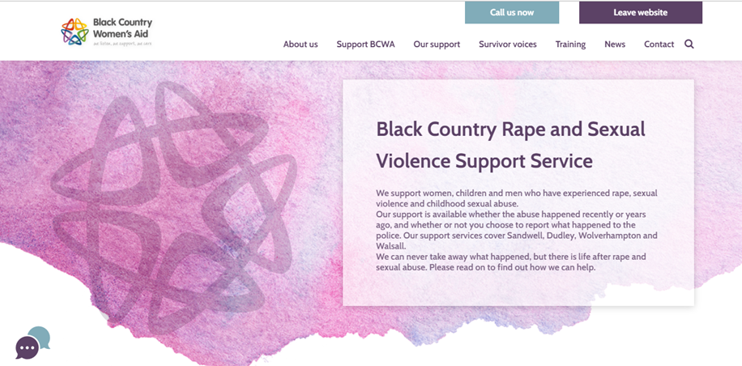
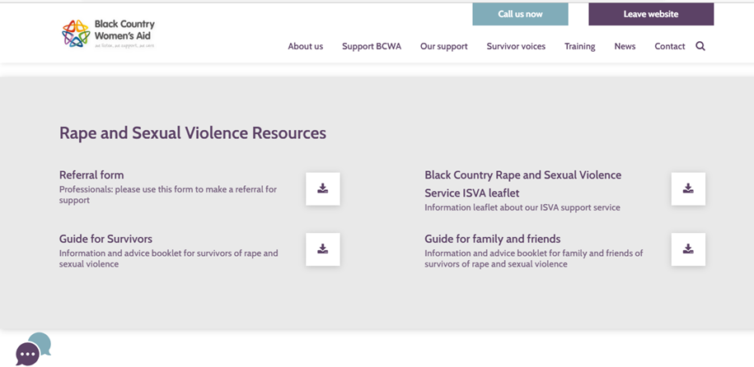
Professional referral
Black Country Women’s Aid.co.uk > Rape and Sexual Violence service> scroll down to Rape and Sexual Violence service Resources> Referral form for professionals.
Notes:
Timing: 2.15
Running time: 17.40

Slide 14
Contact us
Katie Wakefield- Community Development Independent Sexual Violence Advisor
Katie.Wakefield@blackcountrywomensaid.co.uk
Sexual Violence Single Point of Contact: 0121 553 0090
Black Country Women’s Aid
@bcwomensaid
@bcwomensaid
Black Country Women’s Aid
Notes:
Timing 30s
Running time 18min

